Slide 1
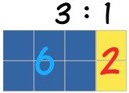

My Proportion Interactive Notebook
Name:
Class:
Teacher:
Term 2 Semester 1

Slide 2
Warm-up Questions:
Topic: Rates EQ: What are the different methods for answering rates questions?
Make sure your summaries from last term are complete. Highlight important information.
Solve x² – 14x + 51 = 0
Write 0.28 as a fraction in its simplest form.
4. Expand and simplify (x + 4)(x + 6)
5. The probability of Oliver scoring a penalty is 0.7. He takes 30 penalties. How many goals should he score?

Slide 3
24
7
30
Date
Rates
EQ – What are the different methods for answering rates questions?

Slide 4
Ratios practice
Ratios
Red to blue ___________________
Blue to yellow ____________________
Yellow to ALL the colours _______________
Red to the rest of the colours ________________
Bue to red to yellow __________________

Slide 5
24
7
30
Date
Rates
EQ – What are the different methods for answering rates questions?
What are rates?
A rate compares related quantities with different units.
Rates are usually written with one quantity compared to a single unit of the other.
For example
50km per 1 hour
(written like 50km/h)
Can you think of any other common rates? Do a quick write for 1 minute on all the rates you can think of.

Slide 6
24
7
30
Date
Rates
EQ – What are the different methods for answering rates questions?
How do use rates?
Given a rate is for 1 unit (50km per 1 hour), if we have more than 1 of those units we can simply multiply by how many we have.
For example,
if we drive at 50km per 1 hour (50km/h) for 3 hours
50 x 3 = 150km
Make sure the units are match the rate first!
if we drive at 50km/h for 30 minutes

Slide 7
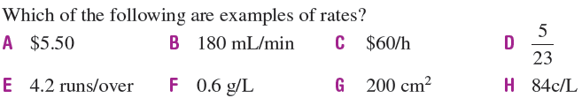
Let’s try some together

Slide 8
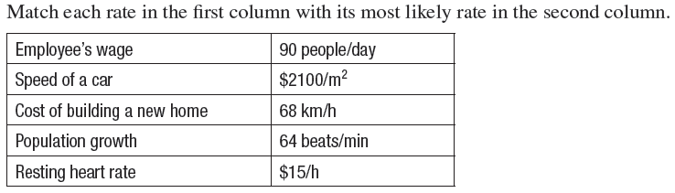
Let’s try some together
From the examples above
(a) If an employee works for 5 hours, how much will they earn?
(b) How many times will a heart beat in 15 seconds?

Slide 9


Slide 10

Now your turn!
Turn to page 151 and have a go at Exercise 11.7

Slide 11
Notes Review
24, 7 ,30
Date
Title
Essential question
Notes complete
Notes complete with colour and diagrams
Questions completed
Contents page filed in
Formula page filled in

Slide 12
Homework
Review your notes and write a summary answering the essential question.

